Slide 1
WITH US APP
A technology company with a focus in Electric mobility, Rideshare, Delivery technologies, Electric Car development, and Financial services. Ride with us app is on your App Store and the first Rideshare App platform that brings all our ride members to one ecosystem marketplace of the future.

Slide 2
ABOUT US
BUY RIDE APP SHARES
Ride App INC is a Private Technology Company. Accredited Investors can buy
direct share plans. Manage individual Account. Get real Time valuations and more.
Finance Technologies
Electric Scooters
Electric Vehicles
Delivery Technologies
Ride App, Inc has released Ride Debit Cards and Ride Credit cards in the U.S.
www.getridedebitcard.com
We have currently developed Ride Scooter Version 1.6.
www.ridewithusapp.com
We Are engaging in R&D to release Ride. An Electric Hybrid Vehicle, completely built with ride technologies that we promise will change the game.
www.rideappincglobal.com
Delivery Technologies are a key strategy to keep both Clients and Businesses engaged. Ride with us app will be releasing Delivery features in the following product cycles.
www.ridewithusdelivery.com

Slide 3
HOW IT WORKS
Target Markets
Buy
Shares
Money
Growth
Purchase shares of ride App, Inc currently at $5.00 a share
We are entering new markets in the U.S., South America, African, and the Caribbean in 5 years.
Technology network companies are highly lucrative and complex global entities. It is tremendous profits with reasonable risk.

Slide 4
REQUEST to be an INVESTOR
Invest, Make Money and Grow with Us
You Can Make Investments From
$100 ^{To} $25,000
You Can Buy, Sell And Mange Your Investments On www.rideinvestorcenter.com
Invest In Ride App INC
www.rideinvestorcenter.com | www.ridewithusapp.com | www.getridedebitcard.com

Slide 5
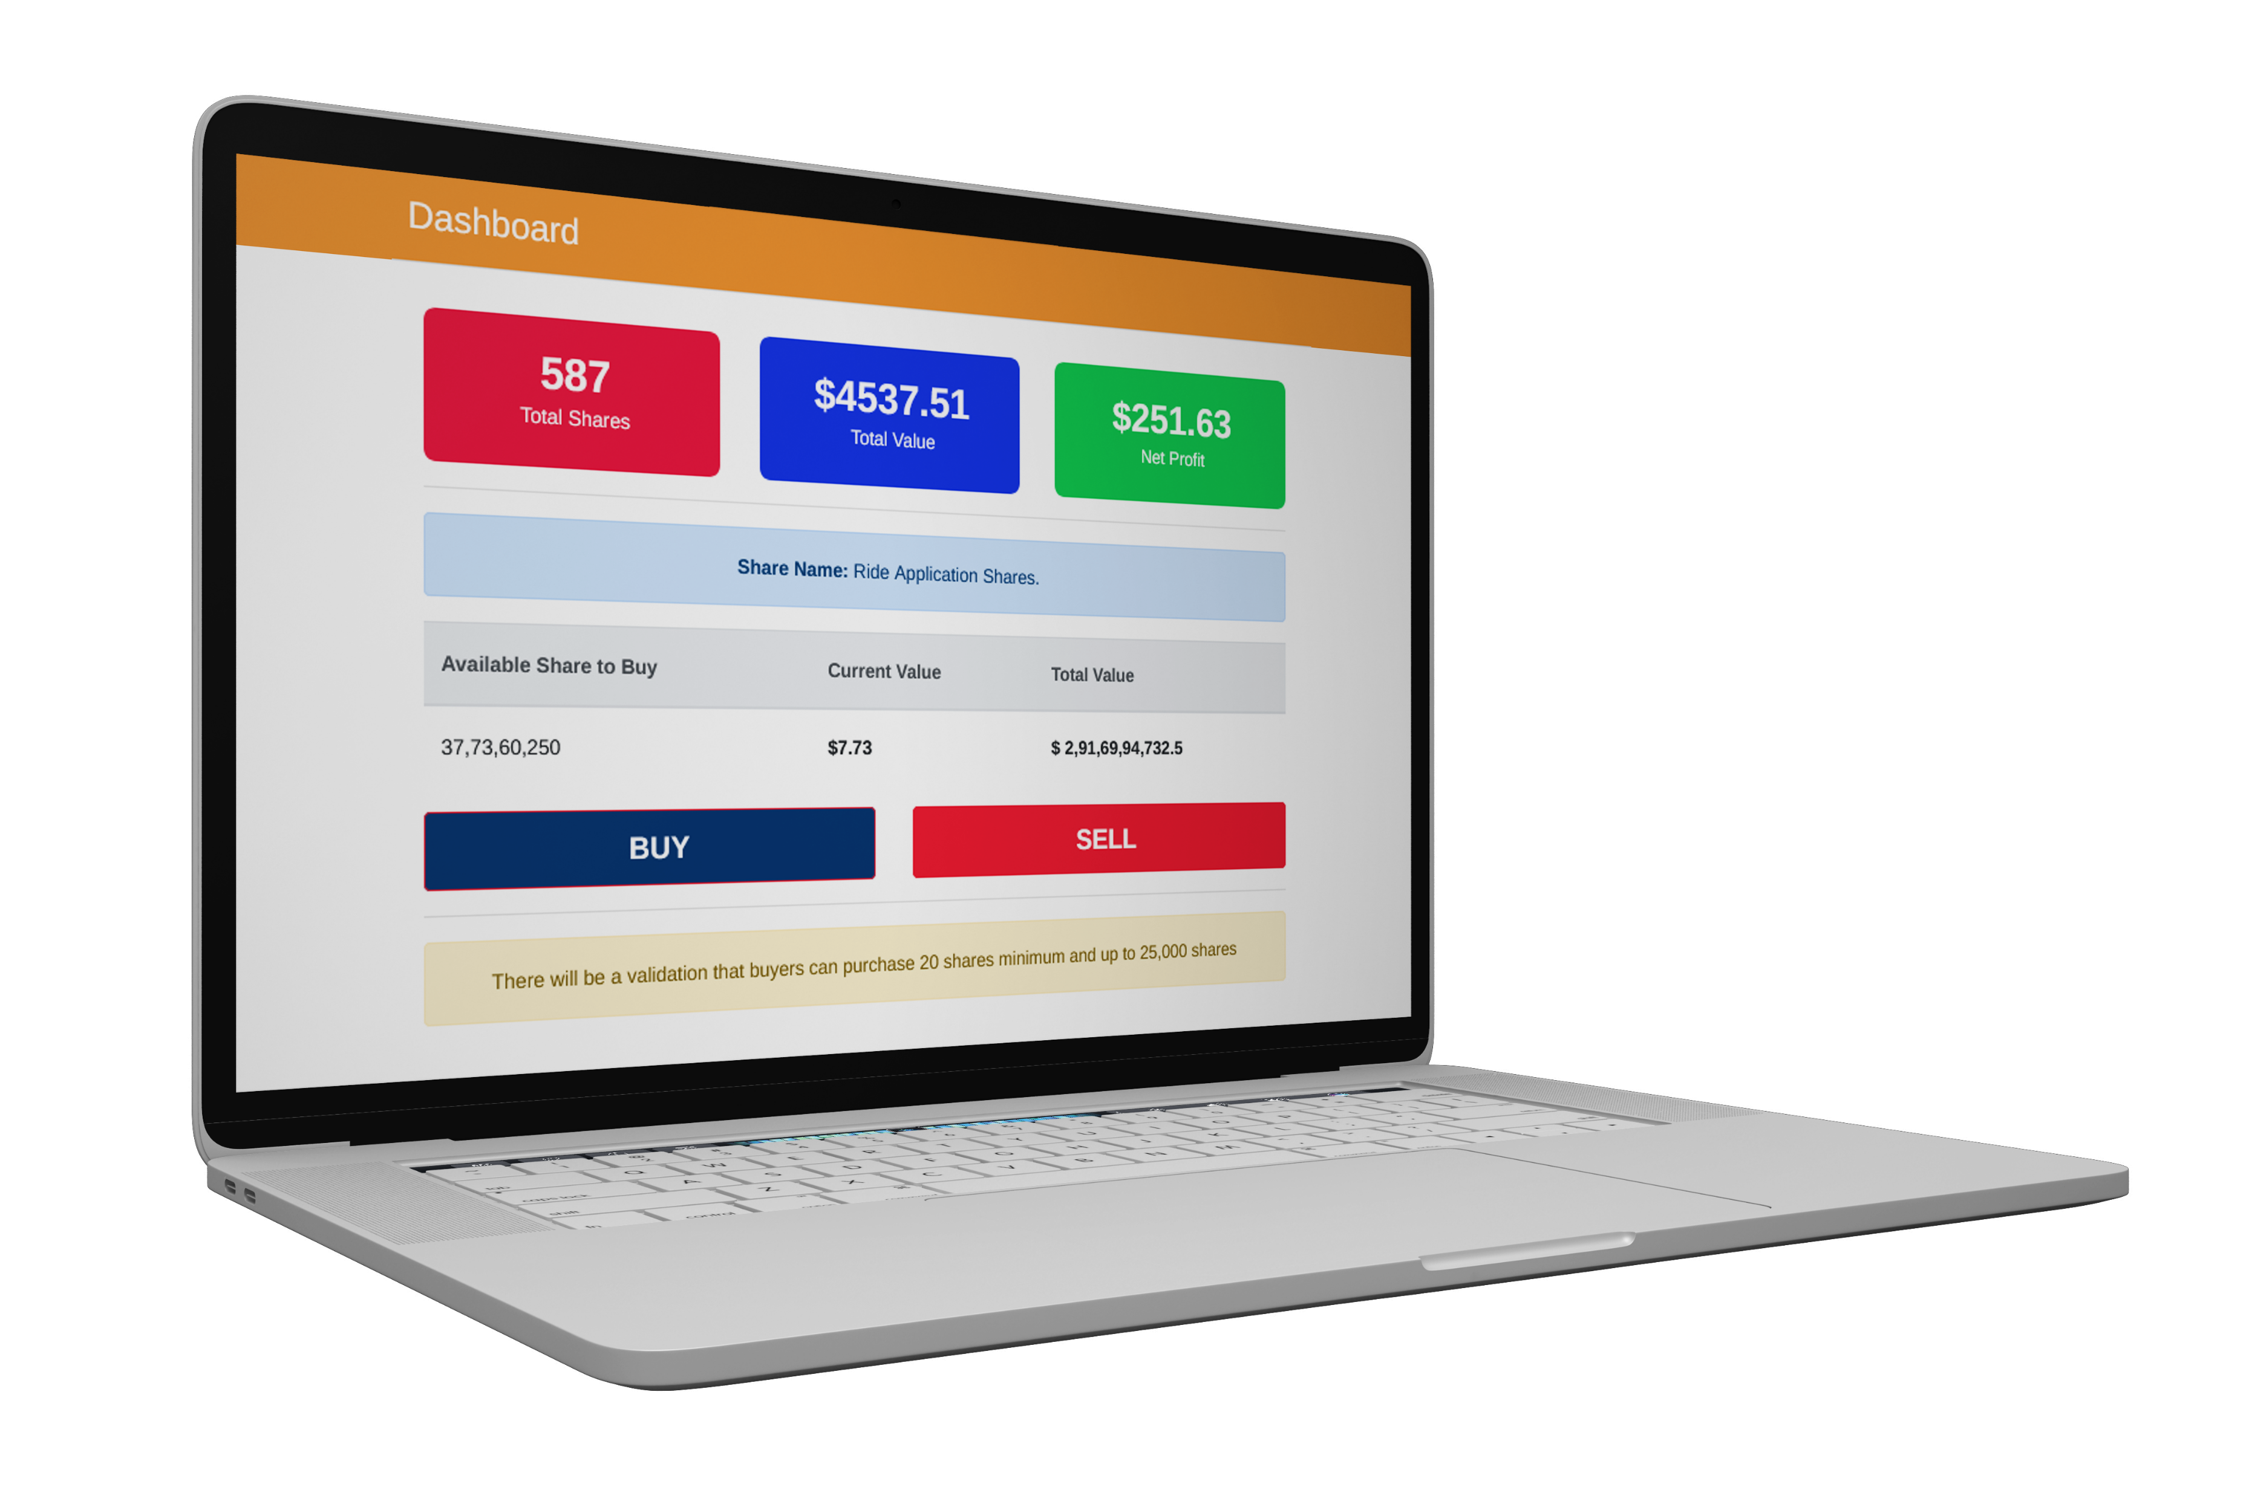
Investors get a dashboard that tracks sales, total values, & net profits. Dividends are paid directly to investor accounts.
DASHBOARD

Slide 6
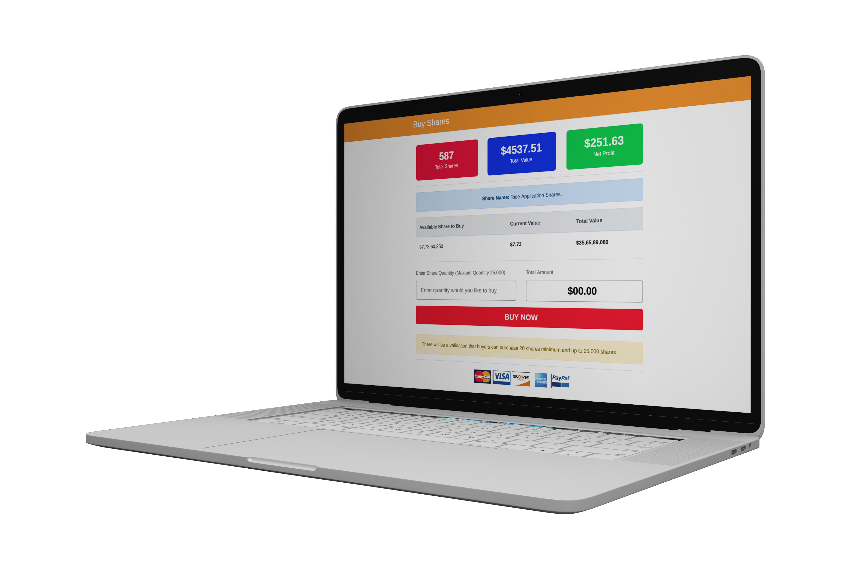
Purchase Ride App, INC Shares for a Commission of $5.95. Reoccurring Investments and direct purchase plans are available.
BUY SHARES

Slide 7
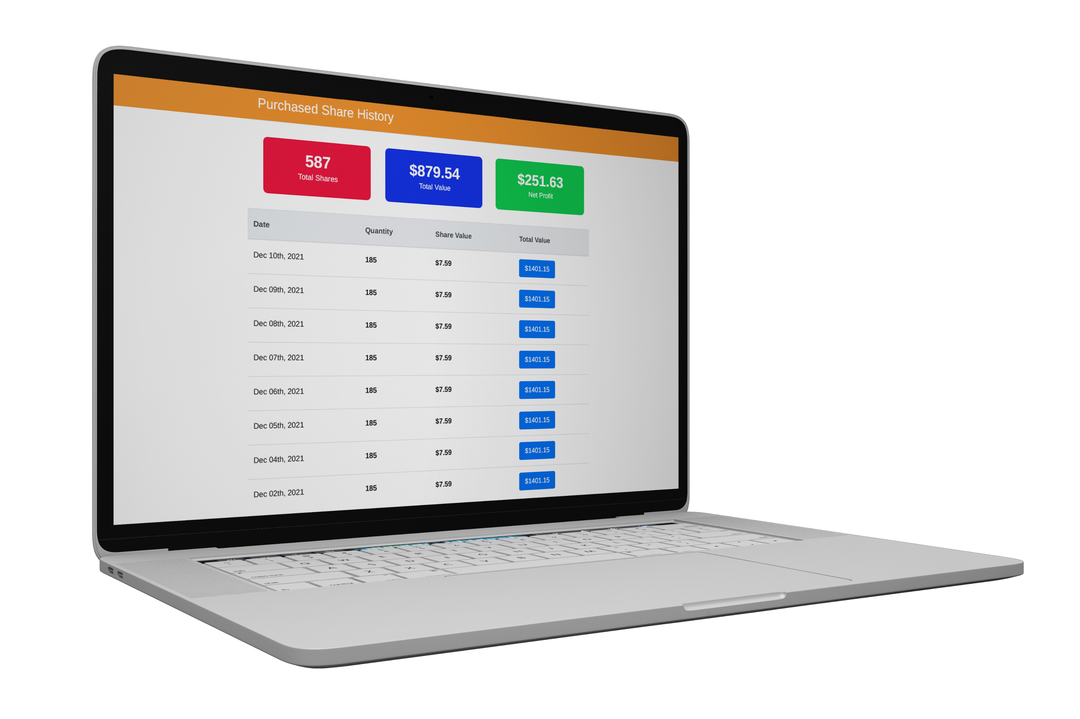
PURCHASE
SHARE HISTORY

Slide 8
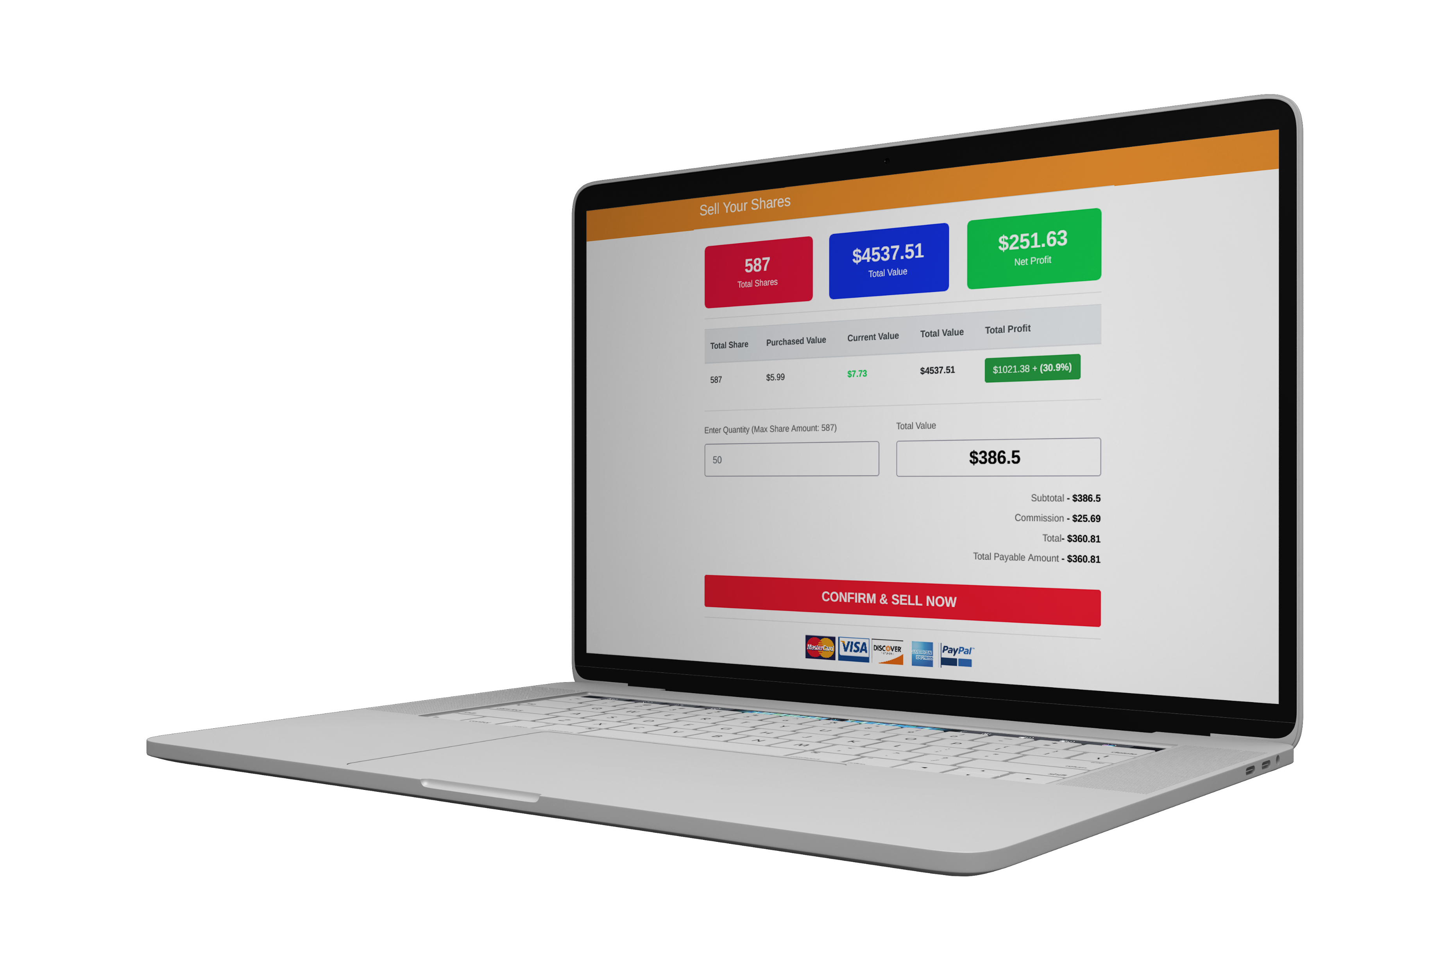
SELL SHARES

Slide 9
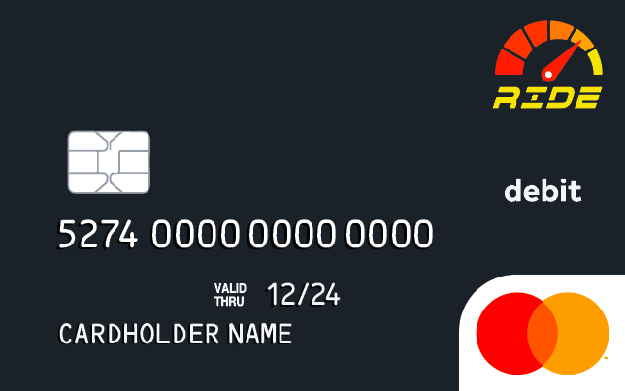
RIDE DEBIT CARD
www.getridedebitcard.com is the financial Arm for the Ride App INC brands.

Slide 10
What are We investing in
Global Marketing
Research & Development
Buying Companies

Slide 11
Ride with us App
Our Core business is the Ride with us App. We intended to build a membership of active daily users in the millions.
Invest in Ride App INC we are a private company. Organized in the state of Louisiana. We Currently operating in select cites.
Purchase Shares now
Purchase Shares Now

Slide 12
2022 financial Projections
Without outside investment.
This Statement is forward looking.
^{$200,000}
^{Ride share}
^{5 states}
We based this projection of less than five percent market share in the 5 states.
^{$385,000}
^{Ride Financial services}
We based this projection on 5 dynamic cards 15 new features roll out in line with our Mastercard & Visa partner.
^{$120,000}
Scooters & business Delivery services
We based this on the assumption that the ride delivery brand acquires at least one contract this year.
We Currently have no Revenue we are a start-up company.

Slide 13
CURRENT
TARGET MARKET
For Ride with us App.
Geological
We are will seek to do business in the State of:
Arizona
Texas
Alabama
Georgia
Mississippi
AGES
The Ages we are targeting for Drives & Passengers are the same.
All Genders from ages 25 to 65
Income
Income levels are from 18,500 a year and up
General Interest of Target Market
Generally, City Commuters looking to get back & forth to work, social engagements , and airports.

Slide 14
ROADMAP
Accomplish TNC Insurance
Release Rideinvestorcenter.com
Employee Stock plans & seek Accredited Investors.
Conference engagements and sponsorships
Implement Ride App business plan.
Fully “Staff and capitalized.
01
03
05
02
04
Open State of Arizona & Alabama
Hire Staff and implement Corporate Structure and business models.

